Slide 1
CS-2001 Data Structures
Priority Queue & Heap
Week 13| Lecture 34-36

Slide 2
Priority Queues
A priority queue is a type of queue in which each element in a queue is associated with some priority, and they are served based on their priorities. If the elements have the same priority, they are served based on their order in a queue.
push(): It is used to insert a new element into the Queue.
pop(): It removes the highest priority element from the Queue.
peep(): This function is used to retrieve the highest priority element from the queue without removing it from the queue.

Slide 3
Priority Queues
The linked list of priority queue is created in such a way that the highest priority element is always added at the head of the queue. The elements are arranged in a descending order based on their priority so that it takes O(1) time in deletion. In case of insertion, we need to traverse the whole list in order to find out the suitable position based on their priority; so, this process takes O(N) time.
Insert 55
Head/Front/Rear
15 | AC | Next*
25 | Bd | Next*
45 | Ki | Next*
79 | Zx | Next*
15 | AC | N*
25 | Bd | N*
45 | Ki | N*
55 | Ki | N*
79 | Zx | N*

Slide 4
Heap
A Heap is a special Tree-based data structure in which the tree is a complete binary tree. It follows the Heap Property
Max-Heap: In a Max-Heap the key present at the root node must be greatest among the keys present at all of it’s children. The same property must be recursively true for all sub-trees in that Binary Tree.
Min-Heap: In a Min-Heap the key present at the root node must be minimum among the keys present at all of it’s children. The same property must be recursively true for all sub-trees in that Binary Tree.
A heap can be implemented in 2 ways –
Tree Node Implementation with pointers
Heap as Array Implementation

Slide 5
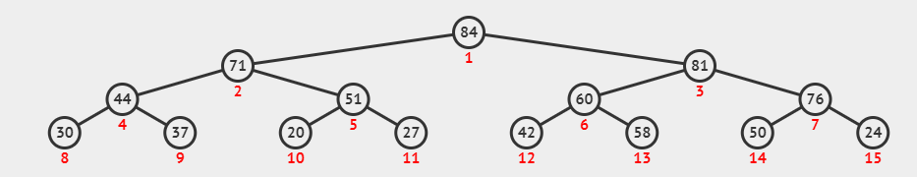
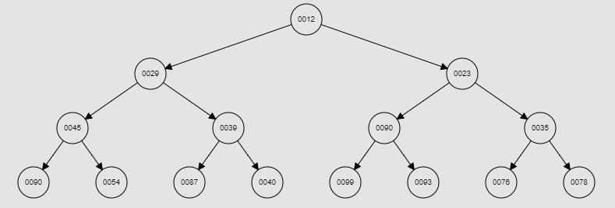
Heap visualization
MAX
MIN

Slide 6
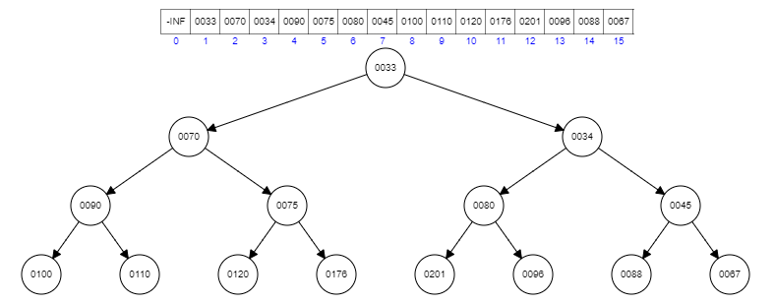
Manipulation in Heap
Arranging the Heap DS elements in an Array structure (min - heap).
The representation is done as
The root element will be at A [0]
Below table shows indexes of other nodes for the ith node i.e., A [i]:
A [(i-1)/2] Returns the PARENT node
A [(2*i)+1] Returns the LEFT child node
A [(2*i)+2] Returns the RIGHT child node

Slide 7
Functions in Heap
Operations using Heap DS
getmin(): It returns the root element of Min Heap. Time Complexity of this operation is 0(1). getMax(): It returns the root element of Max Heap. Time Complexity of this operation is 0(1).
extract Min(): Removes the minimum element from MinHeap. Time Complexity of this Operation is O(Logn) as this operation needs to maintain the heap property (by calling heapify() after removing root.
insert(): Inserting a new key takes O(Logn) time. We add a new key at the end of the tree. IF new key is greater than its parent, then we don't need to do anything. Otherwise, we need to traverse up to fix the violated heap property
delete(): Deleting a key also takes O(Logn) time. We replace the key to be deleted with minium infinite by calling decreasekey(). After decreaseKey), the minus infinite value must reach root, so we call extractMin() to remove the key.
heapify(): Heapify is the process of creating a heap data structure from a binary tree. It is used to create a Min-Heap or a Max-Heap.

Slide 8
Insertion In Heap
void insertKey(int k) {
IF heap_size == capacity
THEN 🡪
print("Overflow: Heap full")
return
heap_size++
i = heap_size - 1
harr[i] =k
WHILE (1!= 0 AND harr[parent(i)] > harr[i])
swap (harr[i], harr[parent(i)])
i = parent(i) // return (i-1)/2
}
int parent(int i)
{
return (i-1)/2
}

Slide 9
int parent(int i){ return (i-1)/2 } int left(int i) { return (2*i+1) } int right(int i) { return (2*i+2) } void swap(int &x, int &y){ temp = x x=y y=temp}
Extract Min & Heapify
int extractMin() {
IF heap_size <=0
THEN-> return INT_MAX
IF heap_size == 1 THEN heap_size--
return harr[0]
root = harr[0]
harr[0]= harr[heap_size-1]
heap_size--
MinHeapify(0)
return root
}
void MinHeapify(int i) {
l=left(i)
r=right(i)
smallest =i
IF l<heap_size AND harr[l] <harr[i]
THEN 🡪 smallest =1
IF r <heap_size AND harr[r] <harr[smallest]
THEN 🡪 smallest =r
IF smallest != I THEN 🡪
swap(harr[i], harr[smallest]) MinHeapify(smallest)
}

Slide 10
int parent(int i){ return (i-1)/2 } int left(int i) { return (2*i+1) } int right(int i) { return (2*i+2) } void swap(int &x, int &y){ temp = x x=y y=temp}
Delete in Heap
void deletekey(int i){
decreaseKey (i, INT_MIN) extractMin()
}
void decreaseKey(int i, int new_val) {
harr[i] = new_val
WHILE(i!= 0 AND harr[parent(i)]> harr[i])
swap( harr[i], harr[parent(0)])
i = parent(i)
}
void MinHeapify(int i) {
l=left(i)
r=right(i)
smallest =i
IF l<heap_size AND harr[l] <harr[i]
THEN 🡪 smallest =1
IF r <heap_size AND harr[r] <harr[smallest]
THEN 🡪 smallest =r
IF smallest != I THEN 🡪
swap(harr[i], harr[smallest]) MinHeapify(smallest)
}
int extractMin() {
IF heap_size <=0
THEN-> return INT_MAX
IF heap_size == 1 THEN
heap_size--
return harr[0]
root = harr[0]
harr[0]= harr[heap_size-1]
heap_size--
MinHeapify(0)
return root
}

Slide 11
Time Complexity
Operations | Unordered Array | Sorted Array | Unordered Linked List | Sorted Linked List | Binary Search Tree | Binary Heap
add | O(1) | O(N) | O(1) | O(N) | O( log N) | O( log N)
peekMin | O(N) | O(1) | O(N) | O(1) | O( log N) | O(1)
removeMin | O(N) | O(1) | O(N) | O(1) | O( log N) | O( log N)

Slide 12
Heap Sort
Heap sort is a comparison based sorting technique based on Binary Heap data structure. It is similar to selection sort where we first find the minimum element and place the minimum element at the beginning. We repeat the same process for the remaining elements.
Steps in Heap Sort (MIN-HEAP)
1. Take size & values of unsorted array from user
2. Heapify the Array
3. Call ExtractMin operation to fetch the root of Min-Heap. Heapify the remaining array again.
4. Repeat step 3 till all values extracted.
Example
1. Take size & Input from User - size = 5, harr[5] ={7,4,3,9,8)
2. Heapify the Array - harr[] = {3,4,7,9,8}
3. Call ExtractMin() - returns - 3
Heapify the Array - harr[] - {4, 8, 7,9}
Call ExtractMin() - return - 4
Heapify the Array - harr[] - {7,8,9}
Call ExtractMin() - return - 7
Heapify the Array - harr() - {8,9}
Call ExtractMin() - return - 8
Heapify the Array - harr() - {9}
Call ExtractMin() - return - 9
Sorted Array Order - {3,4,7,8,9}

Slide 13
Heap Sort Algorithm
void heapSort(){
int temp[capacity]
for(j=0 to j<capacity) {
temp[j]=extractMin()
print(temp[j])
}
}
int main(){
MinHeap obj(s) // size of heap array
obj.getUnsortedArray ( )//get input array from user
obj.printArray ( )//print the unsorted array
for(int i=s/2-1;i>=0; i--) //heapify all nodes
obj.MinHeapify(i) from bottom to top 5.
obj.heapSort(//perform heapsort & print sorted array
}

Slide 14
Heap Sort Complexity
Best | O(nlog n)
Worst | O(nlog n)
Average | O(nlog n)
Space Complexity | O(1)
Stability | No

